Slide 1
Emerging and re-appreciated sexually transmitted infections
IAS STI 2018: Understanding and Addressing the HIV and STI Syndemics
July 22, 2018
Kyle Bernstein, PhD ScM
Chief, Epidemiology and Statistics Branch
Division of STD Prevention
Centers for Disease Control and Prevention
Notes:
Good afternoon everyone and thank you to the Office of Health Equity for the invitation to be a part of this speaker series

Slide 2
Disclosures
None

Slide 3
STIs in context
Over 30 infectious agents have a sexual transmission component
  Some are almost exclusively transmitted sexually (syphilis, gonorrhea)
  Others are primarily transmitted through other routes (Ebola, Zika)
Understanding sexual transmission of pathogens can help inform prevention and control programs as well as populations that may need targeting
  MSM
  Pregnant women

Slide 4
Outline
Emerging STIs
  Ebola virus
  Zika Virus
Re-appreciated STIs
  Neisseria Meningitidis
  Shigella

Slide 5
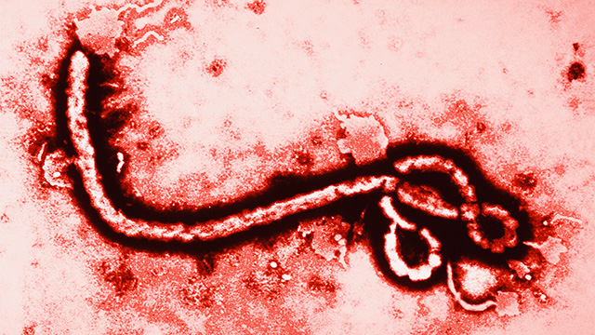
Ebola Virus

Slide 6
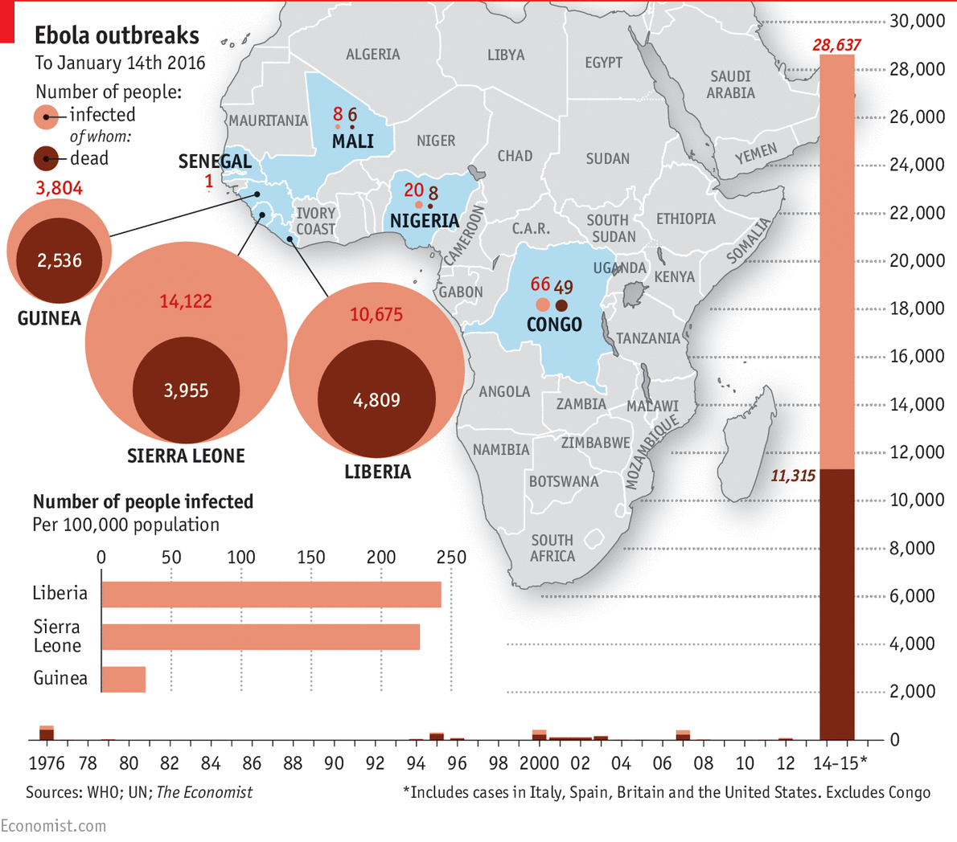

Slide 7
Male and Female Ebola Survivors with Published Results of Laboratory Specimens for Ebola Virus in Vaginal or Semen Specimens, 1976-2015

Slide 8
Section Header
Subhead for Section

Slide 9

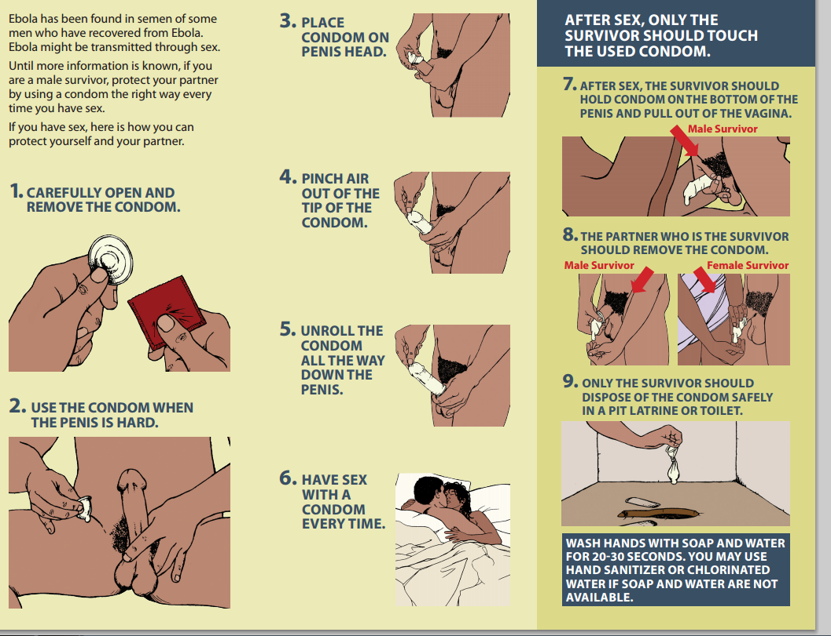

Slide 10
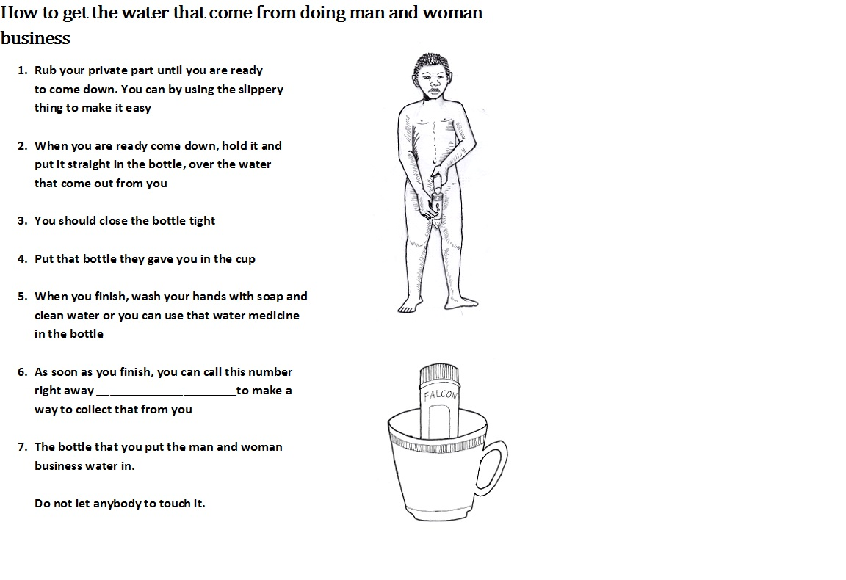
Liberia Men’s Health Screening Program. Courtesy Dr. Mary Choi

Slide 11
Ebola Virus Persistence in Semen
Soka et al. Lancet Global Health 2016;4:e736-43

Slide 12
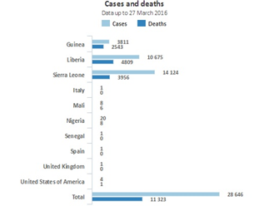
Public Health Implications
Although not quantified, sexual transmission likely has a minimal impact on epidemic spread during large acute outbreaks
West African outbreak left approximately 5,000 male EVD survivors
Sexually acquired EVD may help establish new clusters and flare ups in communities already impacted or in new naïve communities
WHO Ebola Situation Report

Slide 13

Zika

Slide 14
Zika Cases Reported in the United States
January 1, 2015 – August 9, 2017
US States
5,413 Zika virus disease cases reported
  Travel associated cases: 5,140
  Locally acquired cases, mosquito-borne: 224 (Florida – 217, Texas - 6)
  Sexual transmission cases: 47
  Laboratory transmission: 1
  Person-to-person through an unknown route: 1
US Territories
37,007 Zika virus disease cases reported
  Locally acquired cases, presumed mosquito-borne: 36,860*
*Sexually transmitted cases are not reported for US territories because with local transmission of Zika virus it is not possible to determine whether infection occurred due to mosquito-borne or sexual transmission.
47 sexually transmitted cases
http://www.cdc.gov/zika/geo/united-states.html

Slide 15
Sexual Transmission of Zika
Suggested by at least two reports before current outbreak in the Americas
  Possible sexual transmission first reported from US in 2008 after Senegal visit¹
  Recovery of Zika by culture and detection by rRT-PCR in semen of symptomatically infected Tahitian man in 2013²
In early 2016, multiple case reports of sexually transmitted infections
  From travelers returning from areas with active Zika transmission to sex partners who had not traveled
Now reported from at least 13 countries, including the United States³
1. Foy, 2011, Emerg Infect Dis 17(5): 880-882. 2. Musso, 2015, Emerg Infect Dis 21(2): 359-361.
3. http://apps.who.int/iris/bitstream/10665/254714/1/zikasitrep10Mar17-eng.pdf?ua=1 Table 2

Slide 16
Zika Virus in Semen and Risk of Sexual Transmission
Symptom
Onset
(Longest times reported since illness/symptom onset)
Culture (“infectious virus”): 69 days¹
Observed sexual transmission: 32-41 days²
rRT-PCR positive (“viral RNA”): 188+ days³
All data are individual case reports or small case series and
it is unclear how representative they are of population-level risk
1. Arsuaga, 2016, Lancet Infect Dis, 16(11):1107-1108, DOI: http://dx.doi.org/10.1016/S1473-3099(16)30320-6. 2. Turmel, 2016, Lancet; http://dx.doi.org/10.1016/S0140-6736(16)30775-9. 3. Barzon, 2016, Euro Surveill; 21(32):pi=30316 11-August-2016.

Slide 17
Zika Virus in Cervicovaginal Secretions
Symptom
Onset
(Longest times reported since illness/symptom onset)
Culture (“infectious virus”): 3 days¹
Observed sexual transmission: 0 days²
rRT-PCR positive (“viral RNA”)
Vaginal and endocervical swabs: 14 days^{3,4,5}
Cervical mucous: at least 11 days³
1. Penot, 2017, Eurosurveillance, 19 Jan. 2. Davidson, 2016, MMWR Morb Mortal Wkly Rep. 2016;65 (Early Release July 15, 2016 ) 3. Prisant, 2016, Lancet Infect Dis, Jul 11. pii: S1473-3099(16)30193-1. doi: 10.1016/S1473-3099(16)30193-1. 4. Nicastri, 2016, Emerg Infect Dis, 22(12). 5. Murray, 2017, Emerg Infect Dis, epub ahead of print 6. Dudley, 2016, Nature Comm; Jun 28;7:12204. doi: 10.1038/ncomms12204.

Slide 18


About sexual transmission
Zika can be passed through sex from a person who has Zika to his or her sex partners.
  This includes vaginal, anal, and oral sex and the sharing of sex toys.
Zika can be passed through sex, even if the infected person does not have symptoms at the time.
  It can be passed from a person with Zika before their symptoms start, while they have symptoms, and after their symptoms end.
  The virus may also be passed by a person who never has symptoms.

Slide 19
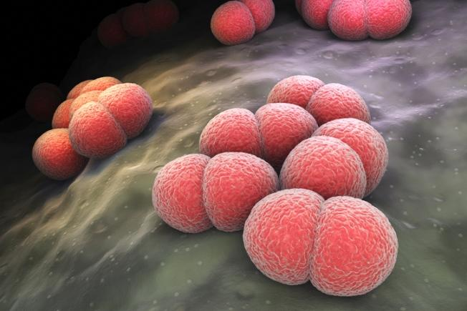
Neisseria meningitidis

Slide 20
N. Meningitidis
Bacterium that causes invasive meningococcal disease (IMD)
Transmitted through droplet
  Has also been isolated from men with urethritis
1972 study found a male chimp infected his own urethra through oral-genital autoinoculation
Dyad and cluster analyses of menigicoccal urethritis show epidemiologically linked sexual partners
IMD outbreaks identified among MSM in US, Europe, and Canada
  Droplet transmission within MSM sexual networks could explain consistently higher N. meningitidis nasopharyngeal carriage rates relative to heterosexual men

Slide 21
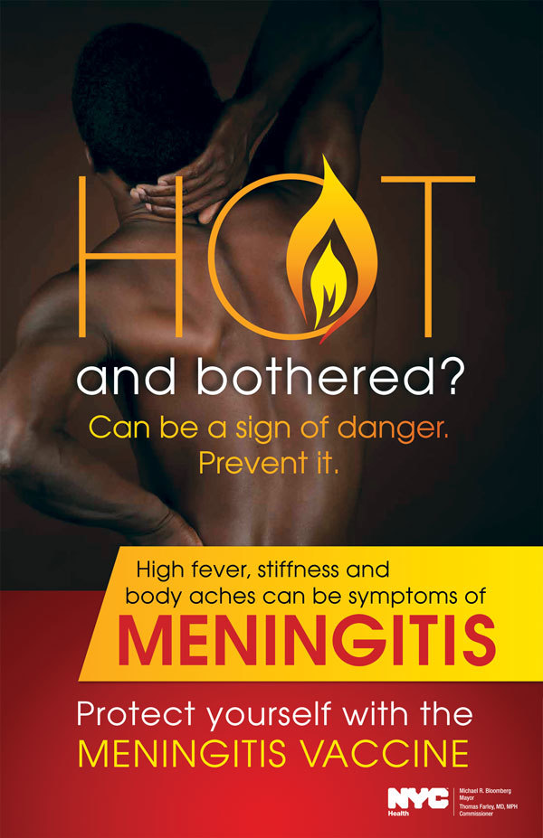
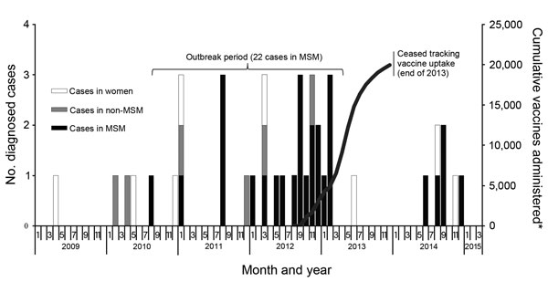
IMD Outbreak in NYC
Kratz MM, et al. Community-Based Outbreak of Neisseria meningitidis Serogroup C Infection in Men who Have Sex with Men, New York City, New York, USA, 2010–2013. Emerging infectious diseases. 2015;21(8):1379–86.

Slide 22
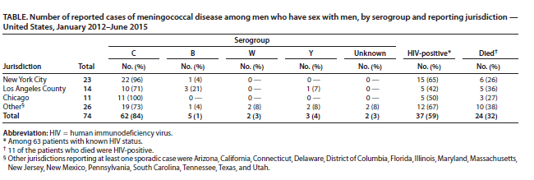
Reported IMD among MSM 2012-2015
Kamiya H,, et al. Meningococcal disease among men who have sex with men—United States, January 2012-June 2015. MMWR Morbidity and mortality weekly report. 2015;64(44):1256–7.

Slide 23
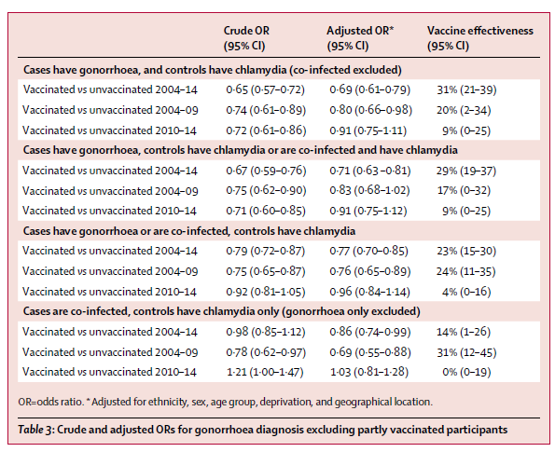
Petousis-Harris H. et al. Effectiveness of a group B outer membrane vesicle meningococcal vaccine against gonorrhoea in New Zealand: a retrospective case-control study. Lancet. 2017 Sep 30;390(10102):1603-1610.

Slide 24
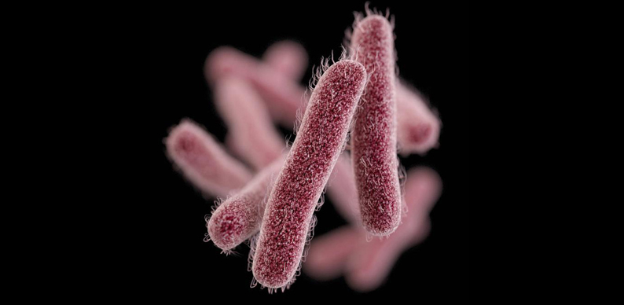
Shigella

Slide 25
Shigellosis
Diarrheal disease caused by bacterium Shigella
  Transmitted by direct or indirect contact with human feces
Typically highest rates occur among children <5 years of age, their care takers and travelers
Transmission can also occur through oral-anal contact or digital-anal sex
In 1970s and 80s, increases noted among US male adults, even as overall rates and rates among children declined
Increases in Shigella among males seen in the UK between 2004-2015
  Male to female rate ratios
Shigella strains circulating among MSM show increasing drug resistance

Slide 26
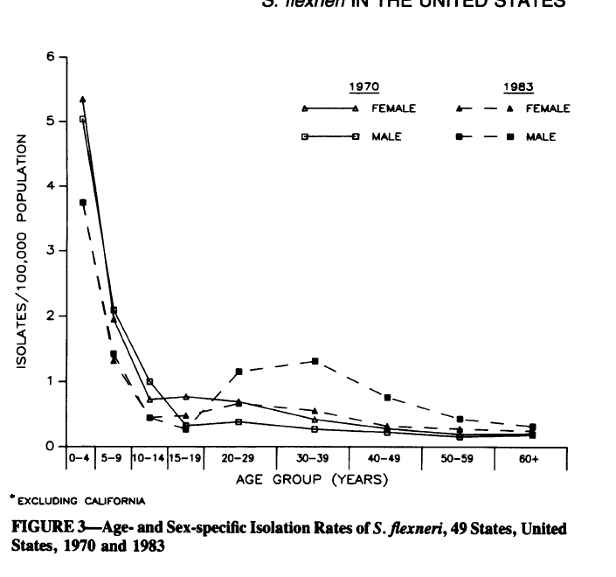
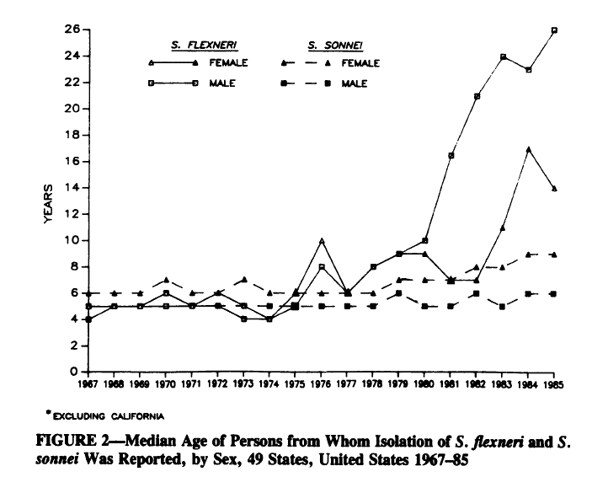
Historic Data Suggests Excess Shigella Risk among Adults Males
Tauxe RV, McDonald RC, Hargrett-Bean N, Blake PA. The persistence of Shigella flexneri in the United States: increasing role of adult males. American journal of public health. 1988;78(11):1432–5.

Slide 27
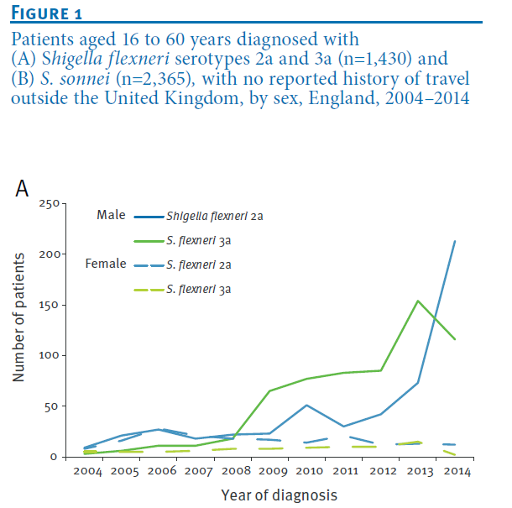
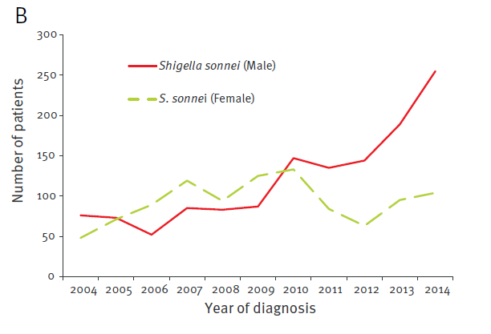
Recent Data Supports Excess Male Risk
Simms I, et al. Intensified shigellosis epidemic associated with sexual transmission in men who have sex with men—Shigella flexneri and S. sonnei in England, 2004 to end of February 2015. Euro Surveill. 2015;20(15).

Slide 28
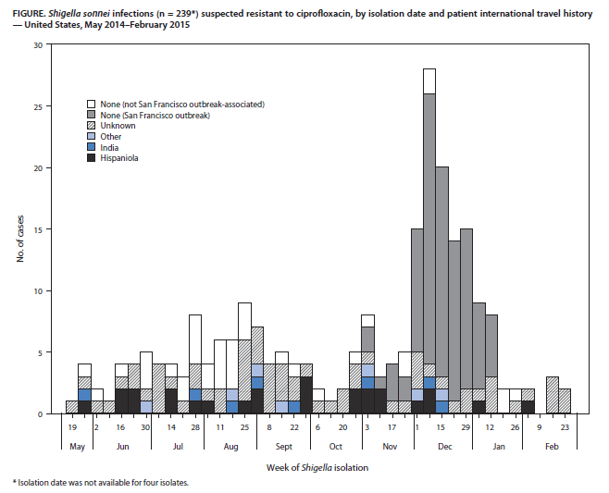
Potential Role of Travel and Ongoing Drug Resistance
Bowen A, et al. Importation and domestic transmission of Shigella sonnei resistant to ciprofloxacin—United States, May 2014-February 2015. MMWR Morbidity and mortality weekly report. 2015;64(12):318–20.

Slide 29
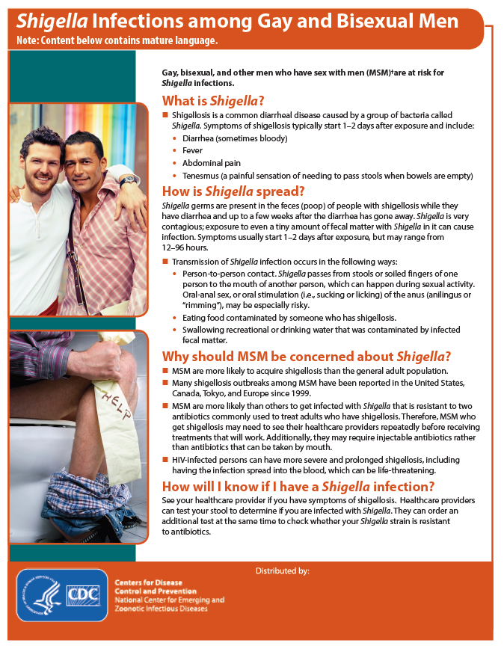
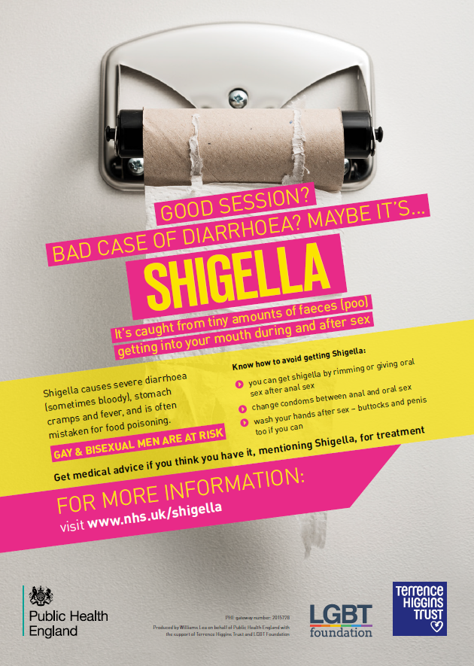

Slide 30
Summary
Many infections have sexual components of transmission
STD clinical and research practitioners can contribute greatly to
  Development of prevention messages and control strategies
  Identification of important epidemiologic data to collect during case investigations
  Establishment of standardized criteria to determining if a pathogen is sexually transmitted

Slide 31

Kyle Bernstein, PhD
kio8@cdc.gov
404 639-8325
For more information please contact Centers for Disease Control and Prevention
1600 Clifton Road NE, Atlanta, GA 30333
Telephone: 1-800-CDC-INFO (232-4636)/TTY: 1-888-232-6348
Visit: www.cdc.gov | Contact CDC at: 1-800-CDC-INFO or www.cdc.gov/info
The findings and conclusions in this report are those of the authors and do not necessarily represent the official position of the Centers for Disease Control and Prevention.

